Slide 1
Gesture-Controlled Dynamic Brightness Adjustment for Computers
Name : Kothamasu Nikhil
Reg no : 9921004374

Slide 2

INTRODUCTION :
Gesture control technology is based on gesture recognition.
Gesture recognition can be seen as a way for computers to begin to understand human body language.
It allows users to change the brightness of their computer screens using hand gestures, without the need for physical controls or traditional settings adjustments.
This technology typically involves the use of sensors, cameras, or other gesture-recognition hardware and software to detect and interpret the user's hand movements or gestures.

Slide 3
SOFTWARE TOOLS :
This technology typically involves the use of sensors, cameras, or other gesture-recognition hardware and software to detect and interpret the user's hand movements or gestures.
Gesture Recognition Software.
Display Brightness Control.
Integration Software.
User Interface.
Programming Skills.

Slide 4
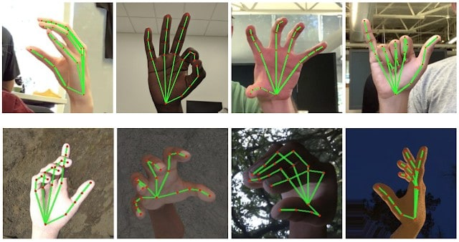
1. Gesture Recognition Software:
Use gesture recognition software to process the input from the hardware and identify specific gestures.
There are various libraries and SDKs available for this purpose, including OpenCV, Intel RealSense SDK, and custom machine learning models.
2. Display Brightness Control:
You'll need software or APIs to control the display brightness programmatically.
This depends on the operating system you're using (Windows, macOS, Linux) and may involve interacting with system-level brightness settings.

Slide 5
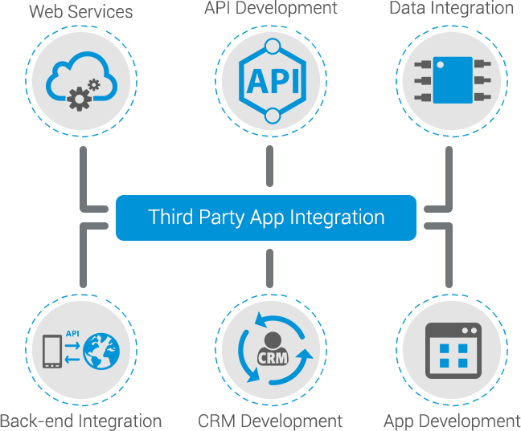

3.Integration Software:
Develop or use middleware software that bridges the gap between gesture recognition and display brightness control.
This software interprets the recognized gestures and sends commands to adjust the brightness accordingly.
4. User Interface:
Create a user-friendly interface that allows users to calibrate, customize, and fine-tune the gesture-based brightness control settings.

Slide 6

5.Programming Skills:
Developing such a system often requires software development skills in programming languages like Python, C++, or Java.
USAGE OF TOOLS :
Usage Scenarios for Gesture-Controlled Dynamic Brightness Adjustment Software:
Enhanced User Experience.
Accessibility.
Gaming.
Multimedia and Content Creation.
Presentations.
Energy Efficiency.

Slide 7
LITERATURE SURVEY
Author Name | Published Year | Title Of Project | Deception of Project | De-Merits
Ching‐Han Chena | August 2019 | Hardware Design of Codebook‐Based Moving Object Detecting Method for Dynamic Gesture Recognition | In this system, we developed a hardware accelerator for real-time moving object detection. It is able to detect the position of hand block in each frame at high speed. | In this project they develop to detect objects like electric –devices. And speed for only for particular objects.
Pruthvi Kumar P | October 2022 | Ai And Ml Based Gesture Controlled Virtual Mouse actions System - A Novel Approach | This proposed system is implemented in Python and it will reduce the likelihood of COVID-19 spreading by eliminating human intervention and the dependency on devices to control the PC directly. | It normally applicable for human interface and depends on power consumption and majorly used in pandemic situation.
Karan Kharbanda | January 2023 | Gesture Controlled Virtual Mouse Using Artificial Intelligence | The system uses Media Pipe and OpenCV for implementing machine learning and deep learning techniques to recognize the hand gestures of the user and perform actions like navigating the cursor, left and right clicks, scrolling, etc. without the use of the physical mouse. | These application works basically without mouse and it will applicable while using the system.

Slide 8
Author Name | Published Year | Title Of Project | Deception of Project | De-Merits
Dariusz J. Sawicki | May 2017 | Gesture Controlled Human–computer Interface For The Disabled | The basic requirement was to replace all functions of a standard mouse without the need of performing precise hand movements and using fingers. The Microsoft’s Kinect motion controller had been selected as a device which would recognize hand movements. | In this project they develop to detect objects like electric –devices. And speed for only for particular objects.
Jayasurya B | January 2021 | Gesture Controlled AI-Robot Using Kinect. | The gesture control robot will save huge cost of labor in future. The basic advantage of this robot is that it will be cost effective and no remote control is required. | This project will be operated by labor and all the content will be updated by robot it leads to lack of security.

Slide 9
TIME LINE :
Intended outcome
Week 1 | 1. Researching different methods for monitoring Gesture-Controlled Dynamic Brightness Adjustment for Computers, identifying potential technologies and equipment to use, and determining the specific goals and objectives of the project. 2.Conduct a literature review to gather information on existing soil health monitoring systems and determine the specific goals.
Week 2 | 1.Clearly define the problem and aims to solve the problem using various techniques. 2.Outline specific goals and aims to achieve solution for them. 3.Creating block diagram for the given problem statement.
Week 3 | 1.Finding the methods and techniques to achieve the problem statement. 2.Making ppt and knowing required components related to problem statement. 3.Knowing uses of component which are used in making the prototypes.
Week 4 | 1.Completed the software part and making ppt and report. 2.Submission of ppt and report to mentor.

Slide 10
OBJECTIVES :
It is to design, develop, and implement a system or software that enables users to control the brightness of their computer screens through intuitive hand gestures.
This project can have several key objectives:
Enhanced User Experience.
Efficiency.
Accessibility.
Energy Savings.
Reduced Physical Contact.
Customization.
Real-time Responsiveness.
Integration.
Versatility.
User Feedback.
Security and Privacy.

Slide 11
BLOCK DIAGRAM
Gesture Recognition Algorithm
Machine Learning Brightness Model
Computer's Webcam and
Sensors
Screen Brightness Adjustment Control
User Interface for Feedback
Image and Video Processing

Slide 12
ALGORITHMS :
The choice of algorithms for Gesture-Controlled Dynamic Brightness Adjustment for Computers depends on several factors.
Here are some commonly used algorithms and approaches for gesture recognition in such systems:
BACKGROUND SUBTRACTION ALGORITHMS :
These algorithms are used for extracting the hand or gesture region from the background in a video feed. Common methods include:
1.Gaussian Mixture Models (GMM)
2.Adaptive Background Subtraction

Slide 13
MACHINE LEARNING AND DEEP LEARNING
CONVOLUTIONAL NEURAL NETWORKS (CNNS) :
Deep learning techniques, particularly CNNs, can be used to recognize hand gestures directly from image or video data. CNNs can be trained to identify specific gestures or patterns.
RECURRENT NEURAL NETWORKS (RNNS) :
RNNs can be used to capture temporal dependencies in gesture sequences. This is particularly useful when recognizing complex gestures that involve a sequence of movements.
PRINCIPAL COMPONENT ANALYSIS (PCA)
PCA can be applied to reduce the dimensionality of gesture data, making it easier to recognize and classify gestures.

Slide 14
HAND TRACKING ALGORITHMS
Kalman Filters :
Kalman filters can be used for tracking the position and movement of the hand over time. They help in predicting the next position of the hand based on previous observations.
Optical Flow :
Optical flow algorithms estimate the motion of pixels between consecutive frames, which can be used to track hand movement.
FUZZY LOGIC
Fuzzy logic can be used to handle imprecise and uncertain inputs in gesture recognition systems.

Slide 15
WORKING
Implementing Gesture-Controlled Dynamic Brightness Adjustment for Computers is a multi-step process that involves hardware setup, software development, and testing.
Below is a step-by-step description of the work involved in this project:
Step 1: Define Project Scope and Objectives.
Step 2: Hardware Setup.
Step 3: Software Development.
Step 4: Gesture Recognition.
Step 5: Brightness Adjustment.
Step 6: Real-time Responsiveness.
Step 7: Calibration and Customization.
Step 8: User Interface (Optional).

Slide 16
RESULT AND DISSUCTION
RESULT
Gesture Recognition Accuracy: Evaluate the accuracy of the gesture recognition system in detecting and interpreting user gestures accurately.
Dynamic Brightness Adjustment: Measure how well the system adjusts the brightness of the computer screen based on user gestures.
User Satisfaction: Conduct user surveys or interviews to assess user satisfaction with the gesture-controlled brightness adjustment system.
Power Consumption: Measure any changes in power consumption due to the dynamic brightness adjustment to evaluate energy efficiency.
Comparison with Traditional Methods: Compare the performance of the gesture-controlled system with traditional methods of adjusting screen brightness (e.g., manual adjustment or ambient light sensors).

Slide 17
DISCUSSION
Effectiveness of Gesture Control: Discuss the accuracy and effectiveness of the gesture recognition system in interpreting user gestures and adjusting brightness accordingly.
User Experience: Analyze user feedback and satisfaction data to determine if users find the gesture-controlled brightness adjustment system convenient and user-friendly.
Energy Efficiency: Evaluate whether the dynamic brightness adjustment system helps in reducing power consumption compared to static brightness settings.
Advantages and Limitations: Discuss the advantages and limitations of the gesture-controlled system compared to other methods of brightness adjustment.
Applications: Consider potential applications beyond computer screens, such as in smart homes, automotive displays, or other interactive systems

Slide 18
REFERENCES
[1] Ching‐Han Chena , Ching‐Yi Chenb , and Nai‐Yuan Liu , August 2019 , Hardware Design of Codebook‐Based Moving Object Detecting Method for Dynamic Gesture Recognition , Vol. 25, no. 2, 375–384.
[2] Pruthvi Kumar P , Dr. Nirmala Shivanand , October 2022 , AI AND ML BASED GESTURE CONTROLLED VIRTUAL MOUSEACTIONS SYSTEM - A NOVEL APPROACH , nternational Journal of Engineering Applied Sciences and Technology, 2022 Vol. 7, Issue 6, ISSN No. 2455-2143.
[3] Karan Kharbanda, Utsav Sachdeva , 01/January-2023 , GESTURE CONTROLLED VIRTUAL MOUSE USING ARTIFICIAL INTELLIGENCE , International Research Journal of Modernization in Engineering Technology and Science , e-ISSN: 2582-5208.
[4] Oskar M. Szczepaniak Dariusz , J. Sawicki, May 2017, GESTURE CONTROLLED HUMAN–COMPUTER INTERFACE FOR THE DISABLED , Medycyna Pracy 2017;68(1):11–21.
[5] Jayasurya B, Jino Justin,Kharat Pooja C,Mrutyunjay A Hasaraddi,Dr. T Kavitha , January 8, 2021 , Gesture Controlled AI-Robot Using Kinect , EasyChair Preprint , № 4875 .

